Slide 1
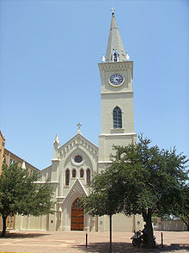
Diocese of Laredo Bishop James A. Tamayo D.D 2012-2013
Lectors’ Workshop

Slide 2
Diocesan Committee on Liturgy and Divine Worship:
“Lector Training”
The Presenters
You!

Slide 3
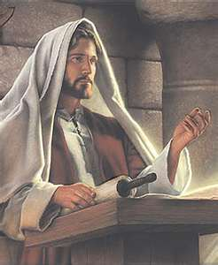
Of what value is the Ministry of Lector
Constitution on the Sacred Liturgy: “Christ is present in His word since it is He Himself who speaks when the Holy Scriptures are read in the Church.”
People hear God’s Word, not read.
Christ speaks through you.
Spoken Word, Dynamic Word, spoken by God.
The story of Mary’s visit to Elizabeth: not when she saw Mary, but when she heard Mary’s greeting!

Slide 4
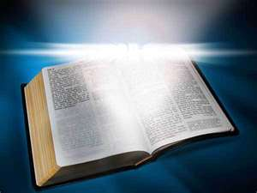
So HOW you proclaim IS IMPORTANT!
Word comes alive! Your role: To let it come alive first in YOU.

Slide 5
The Importance of the Word of God
God’s word is primarily spoken and proclaimed.
What about those who READ from the missalette?
Use the beautiful book of the Lectionary to surround the experience with beauty.
Think of the people who cannot go to Communion you bring His Presence to them in His Word.
Think of the people who cannot read. You proclaim to them.
Your proclamation has power & importance.
God’s Word has power beyond all other words

Slide 6
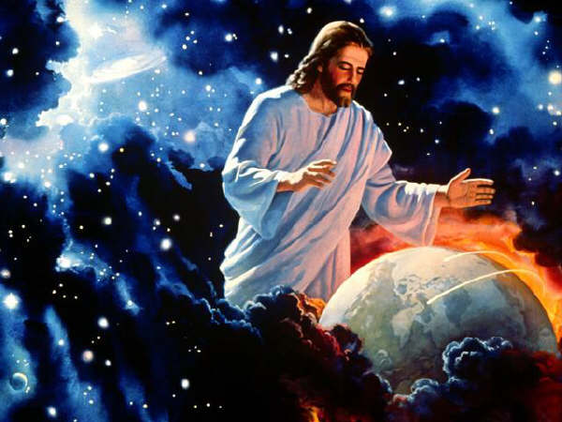
What is God’s Word?
God’s word is Jesus Christ. Reveals our deepest nature as His people.
By His Word He makes Himself present to us.
He calls your parish community into being
Your purpose is to encounter Jesus, to celebrate Jesus.
If truly proclaimed, things happen! Not simply history, but enacted anew, now in my parish.

Slide 7
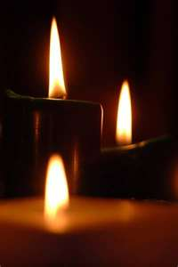
Small group sharing…
What struck you
from the
presentation?....
What more
could you add?....

Slide 8
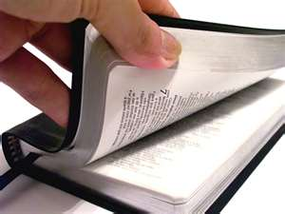
Preparation for serving as a Lector
Is it OK to pick anyone when you need a lector?
Two stories…

Slide 9
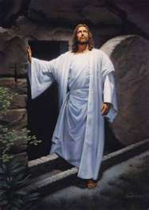
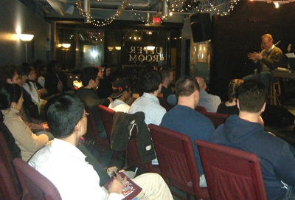
“You knew the text,
… I knew the author.”
No matter how impressive
your platform skills are,
when you don’t know what you’re
reading about, the congregation
is the first to pick it up.

Slide 10
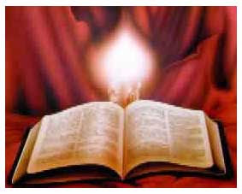
Remote Preparation
Read the bible often.
Pray with the Gospels and psalms.
Learn all you can about the bible from good Catholic sources.
The Diocese has a Pastoral Institute which
has many good courses near
you. Look for them.
Pray the rosary and other devotions.

Slide 11
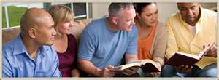
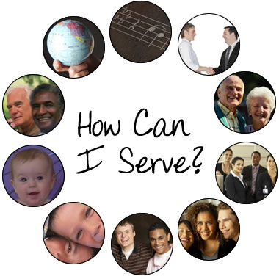
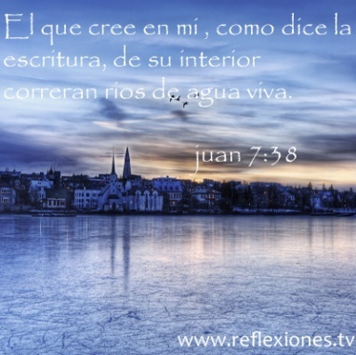
LIVE in the PRESENCE of GOD.
As your time allows, be in a
prayer group or movement.
Be a model for others
even when not in the ambo.
SILENCE. Quiet your heart,
pause, God is present in the
silence. Psalm 45:1 Be still and know that I am God.

Slide 12
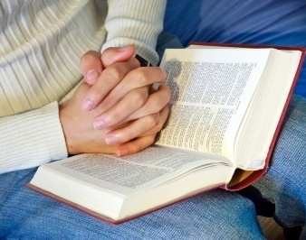
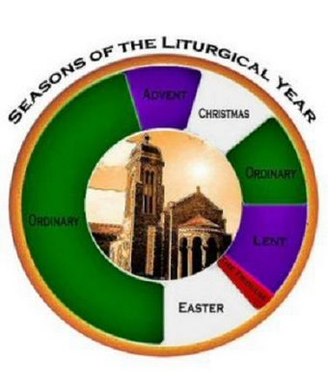
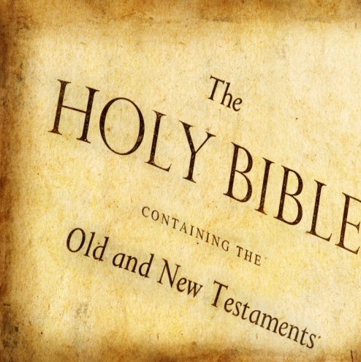
Proximate Preparation
Be very familiar with
what will proclaim.
Your advance study:
In context of whole of scripture.
Within context of
the liturgical year.
Within context of
the other readings of the day.

Slide 13
Study and practice throughout the week.
See in your packet, at the end of the booklet, in the Reference Information and Material a sheet called:
“A suggested Method of Preparation for Proclaiming a Reading”.

Slide 14
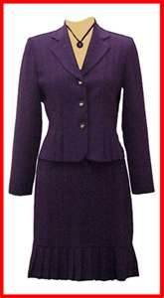
Dress
How we dress to
proclaim the Word
is important.
Reflect the dignity
of the Word.

Slide 15
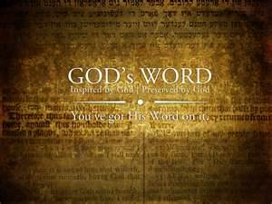
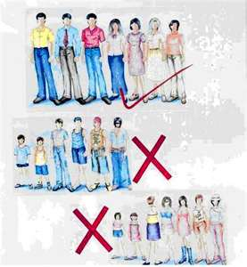
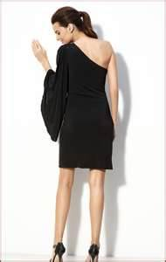
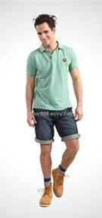
Help the assembly to focus
on God and his Word.
Don’t distract by your clothes or posture

Slide 16
Time for questions ….
This concludes Part I of the Lector Workshop
Proceed now to have a 10 minute break
and then continue with:
Public Speaking Skills to Learn and Practice

